Slide 1

NASA Exoplanets
By Shreyas Patel and Simran Shah

Slide 2
Content
About Dataset
Motivation
Questions
Plot
Statistical Analysis
Conclusion

Slide 3

About Dataset
The NASA Exoplanet Archive is a database that includes details on every exoplanet (a planet beyond our solar system) that has been identified so far by NASA's numerous space missions, ground-based observatories, and other sources.

Slide 4

Observation
Each observation in the NASA Exoplanet Archive dataset represents a planet outside our solar system (an exoplanet) and its host star. The dataset contains details about the exoplanet's characteristics and those of its host star, as well as the techniques used to find it.

Slide 5

Variable
There are 13 variables in the dataset,
name
distance
stellar_magnitude
planet_type
discovery_year
mass_multiplier
mass_wrt
radius_multiplier
radius_wrt
orbital_radius
orbital_period
eccentricity
detection_method

Slide 6

Motivation
The NASA Exoplanet Archive collection can be used for data analytics to gain important insights and information about the features and traits of exoplanets and their home stars. This can help in a better understanding of how planets in our galaxy develop, evolve, and interact with their environments. Data analytics methods can be used to spot patterns and trends in the data, such as relationships between exoplanet mass and radius or between a planet's distance from its star and the possibility that it has an atmosphere. The development of models and ideas concerning the formation and evolution of exoplanets can then be done using these patterns and trends.

Slide 7

Questions
Planets are more likely to be which type?
How much is the average radius for Earth-like planets?

Slide 8
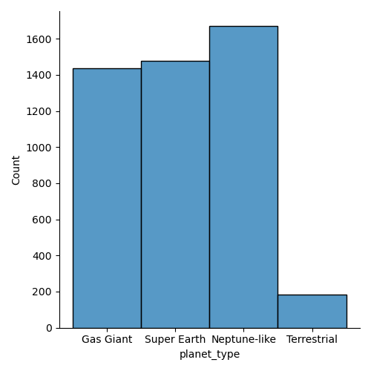
Plot and Interpretation
As you can see from this Neptune-like planets (cold planets) are in the solar system.
Here is the order:
Neptune-Like -> Gas Giant -> Super Earth -> Terrestrial -> unknown

Slide 9
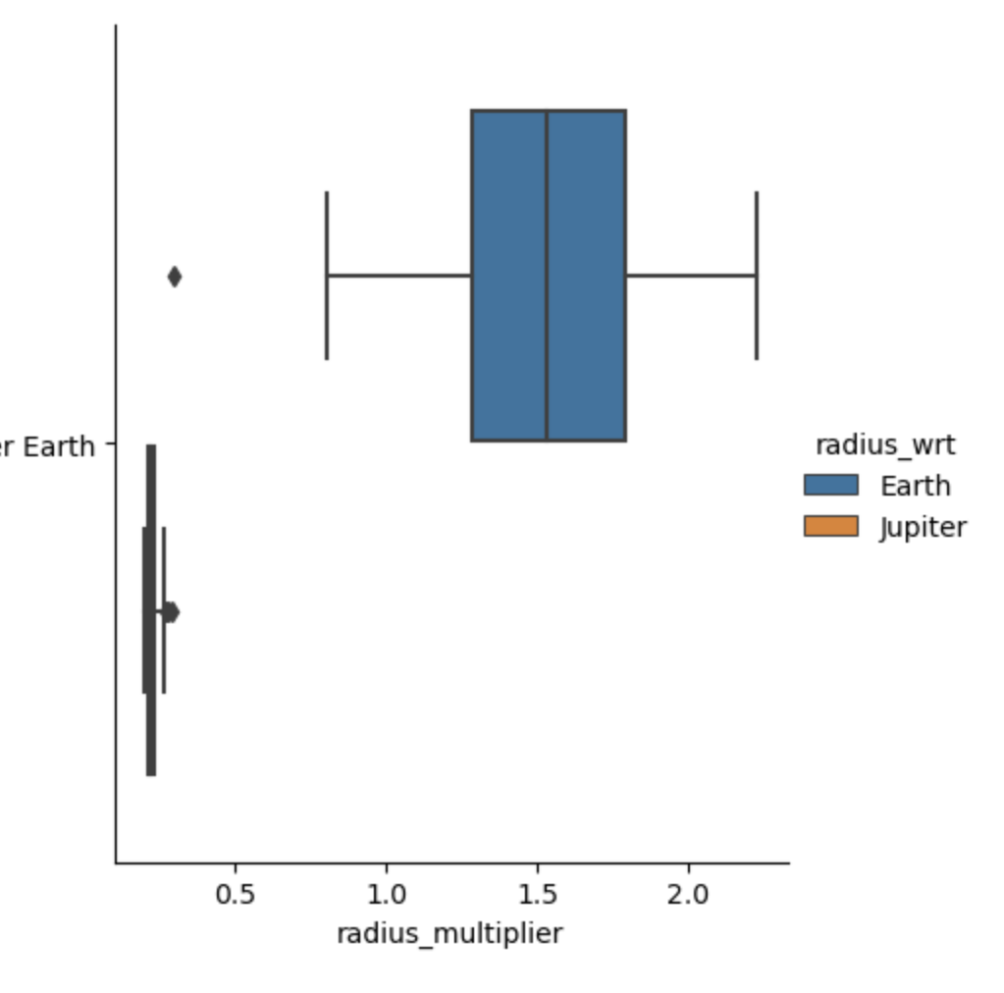
Plot and Interpretation
There are 2 kind of super earth, min radius of jupiter is very less compared to earth.

Slide 10


Statistical Analysis
T-test
There is significant difference between 2 groups as P-value is lower than 0.05.

Slide 11

Statistical Analysis
LinregressResult(slope=-2.4935294256177226e-05, intercept=0.11242792408441929, rvalue=-0.31127384113237555, pvalue=1.4579466024832974e-107, stderr=1.1030661814215443e-06, intercept_stderr=0.00281520198728659)
Linear Regression
We can see from the given Linregress Result that the linear regression line's slope is -2.4935294256177226e-05 and its intercept is 0.11242792408441929. The strength of the linear relationship between the two variables is indicated by the r-value, which is -0.31127384113237555. A weak negative linear relationship between the variables is shown by this negative number.

Slide 12
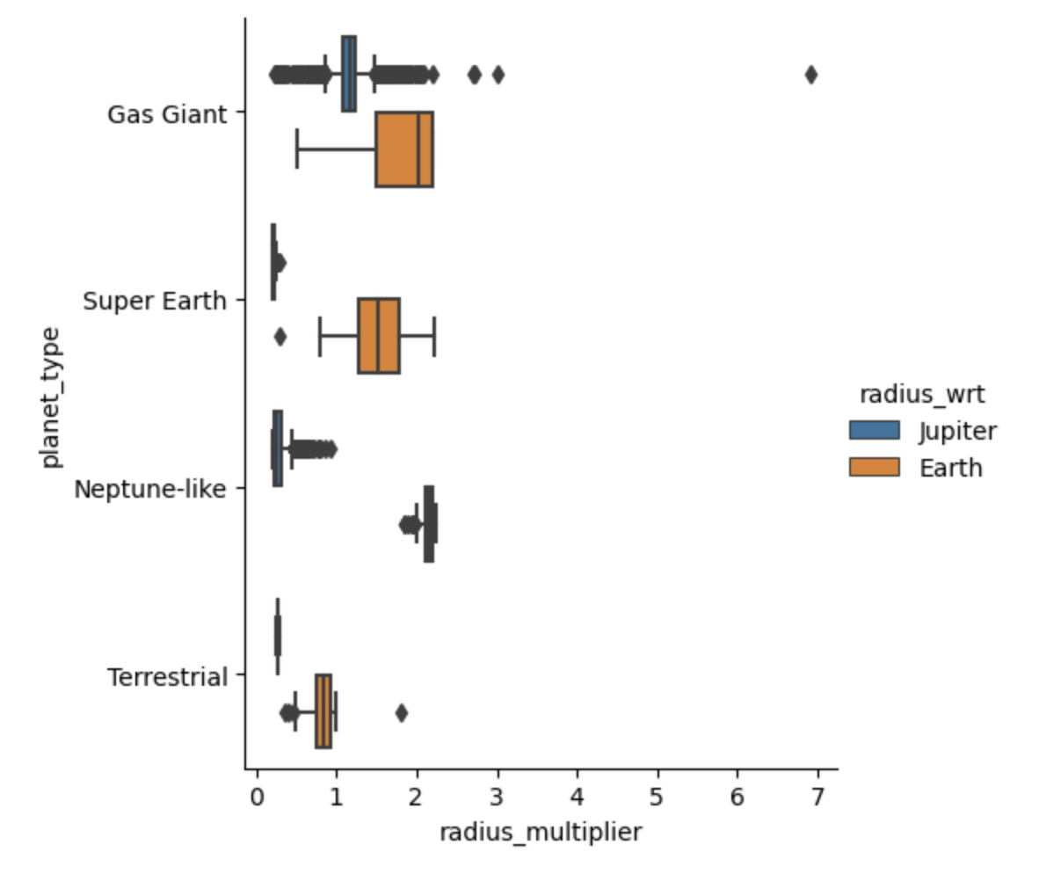
Conclusion
Comparatively, radius multiplier of earth is more than jupiter, although jupiter has higher radius then earth.

Slide 13

Conclusion
Majority of the planets are of type Neptune-like which are cold planets. This makes the claim that the majority of the planets in our universe share Neptune's features as cold planets. As a gas giant with a mostly hydrogen, helium, and methane atmosphere, Neptune is one of the coldest planets in our solar system. The majority of the planets in our universe may not contain the prerequisites for life, according to this assertion, which suggests that they may not be habitable for humans.

